Slide 1
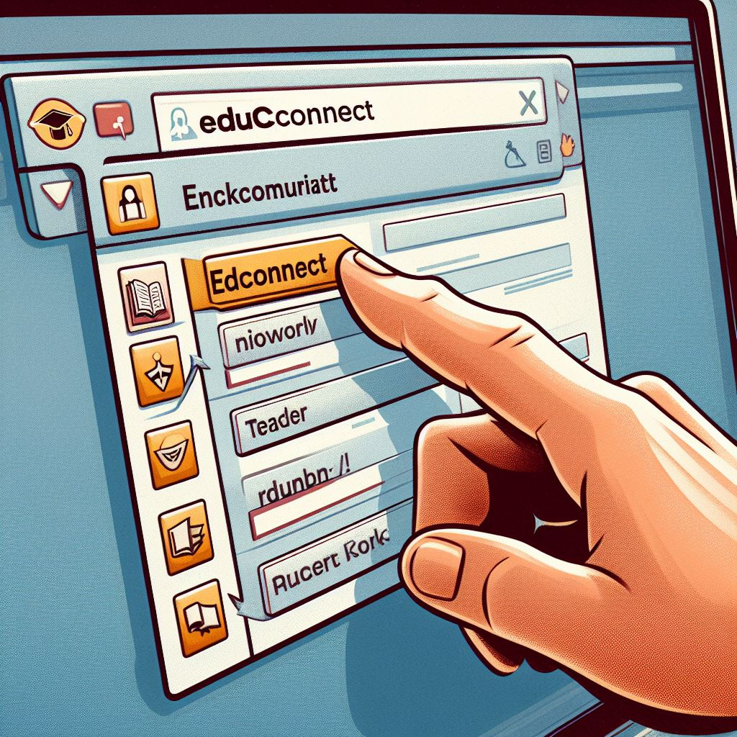
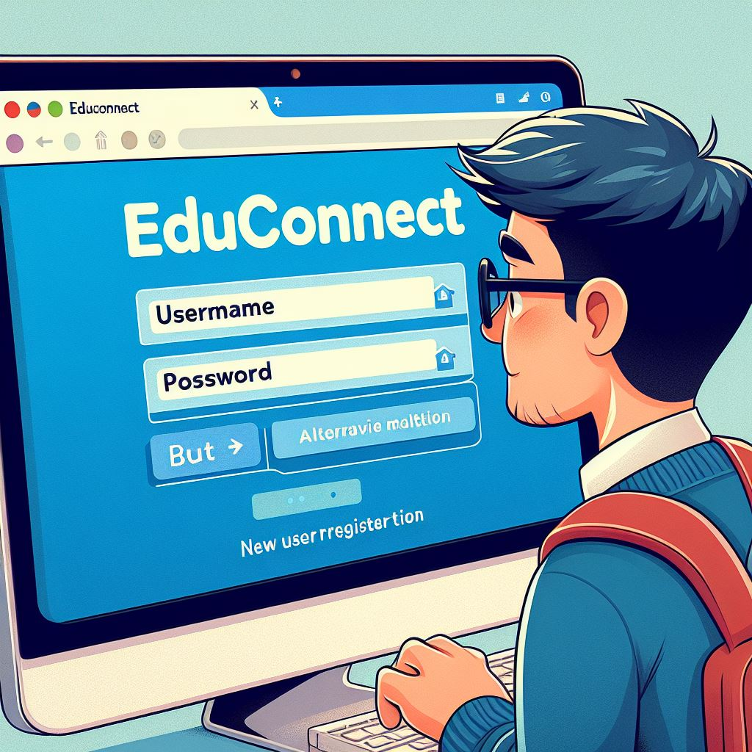
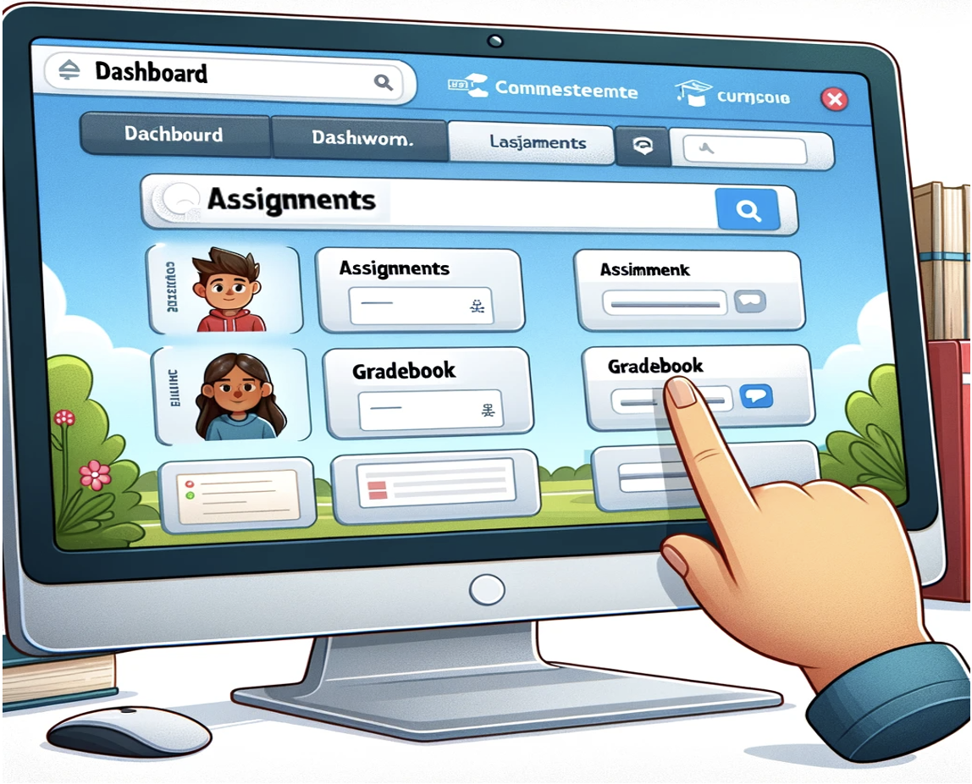
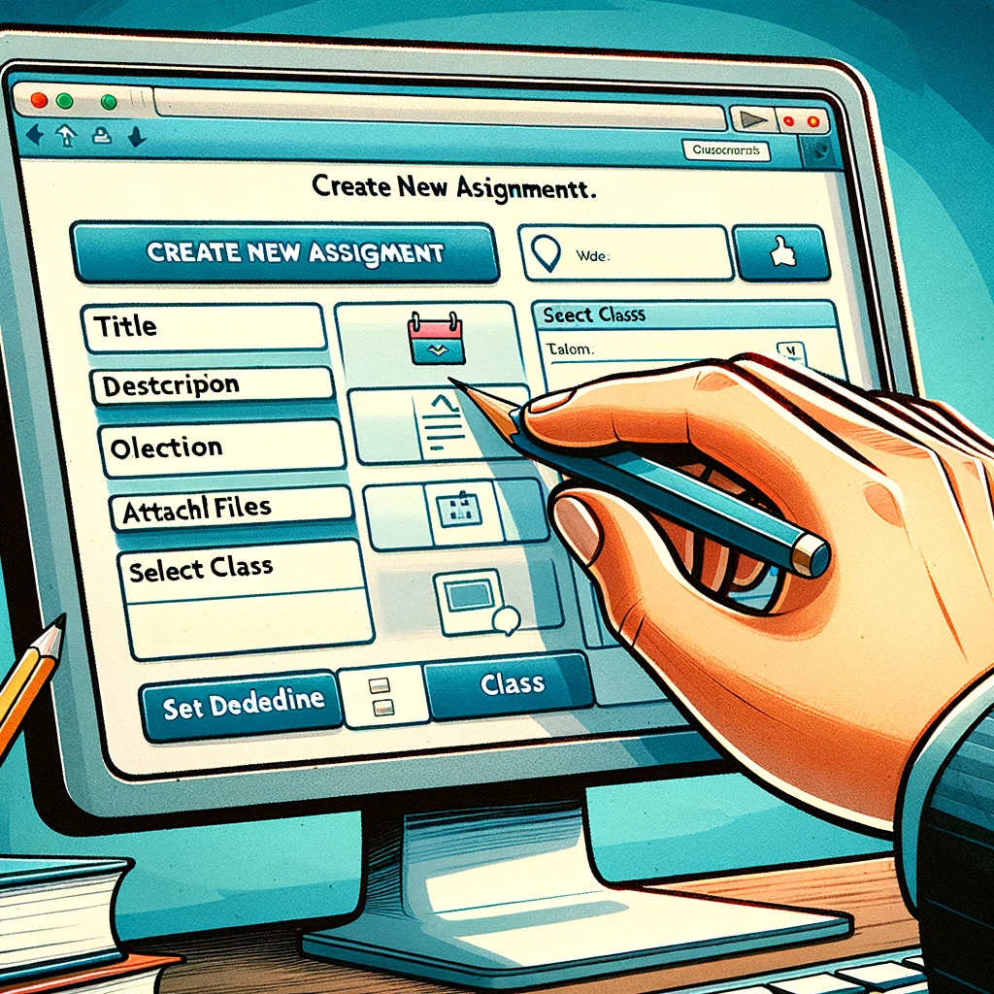

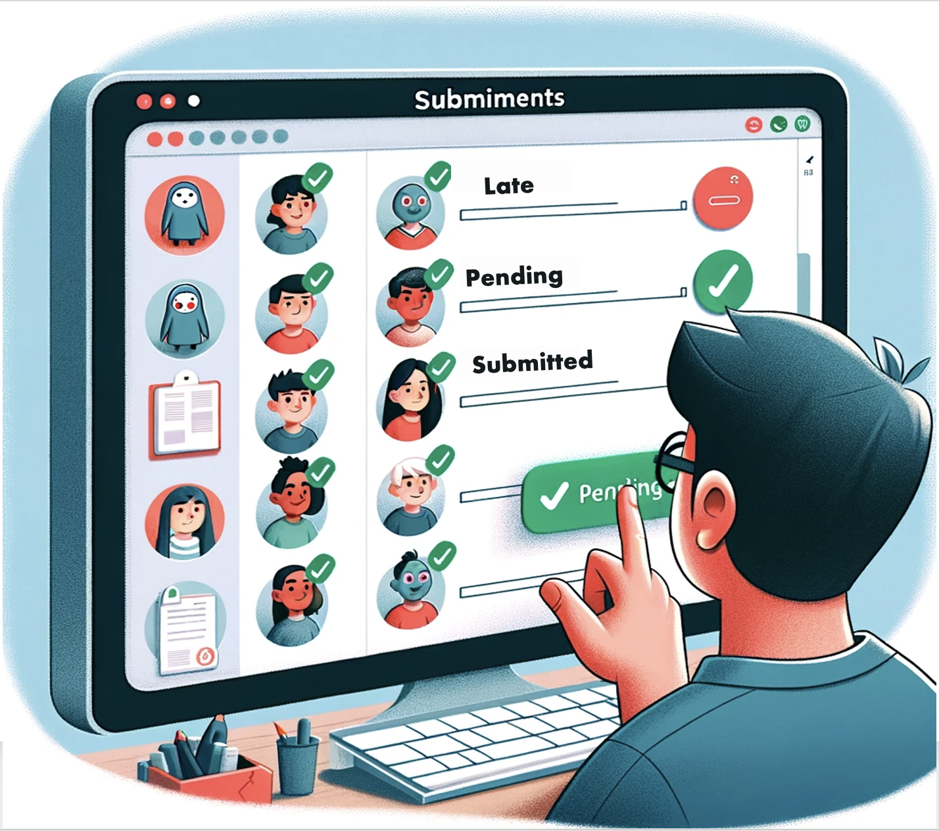
UX Design Storyboard
Scenario: A website that enables educators to efficiently create, assign, and track student homework submissions online.
User opens a web browser and clicks on the 'EduConnect' bookmark to visit the website.
User enters their credentials on the EduConnect login page and clicks 'Log In' or chooses 'Register' for new users.
User lands on the EduConnect dashboard and hovers the cursor over the 'Assignments' section.
User fills in assignment details on the 'Create New Assignment' form on the EduConnect website.
User publishes the assignment by clicking 'Publish' and confirms the action in the pop-up dialog box.
User views student submissions in the 'Assignments' section, noting who has submitted and who is pending.

